Slide 1


Department of Computer Science and Engineering
EVOLVED RETAIL : AUTOMATION GARBAGE CART
Mr.S.Suresh Kumar
PROJECT COORDINATOR
Professor
AADAV SRINIVAS
210701001
ADARSH.R
210701012
DEPARTMENT OF COMPUTER SCIENCE AND ENGINEERING

Slide 2
ABSTRACT
Urban areas worldwide are facing significant challenges in waste management due to rapid population growth and increased urbanization. Traditional waste collection methods, which heavily rely on manual labor and fossil fuel-powered vehicles, have proven to be inefficient, environmentally harmful, and hazardous to the health of sanitation workers. This project addresses these challenges by developing an autonomous garbage cart system utilizing Arduino microcontrollers. collect garbage, and optimize waste collection routes..The hardware setup includes an Arduino microcontroller as the core processing unit, ultrasonic sensors to detect obstacles and navigate around them, and a motorized base to provide movement and stability. .
DEPARTMENT OF COMPUTER SCIENCE AND ENGINEERING

Slide 3
EXISTING SYSTEM
The existing system of waste collection in urban areas primarily relies on manual labor, where sanitation workers collect waste from households, commercial establishments, and public spaces. Waste collection schedules are determined by municipal authorities, with designated routes and intervals for collection. Additionally, manual waste collection poses health and safety risks for workers, who are exposed to hazardous materials and physical strain from lifting and handling heavy waste containers. Furthermore, the reliance on fossil fuel-powered vehicles contributes to air pollution and greenhouse gas emissions, exacerbating environmental concerns. The existing system of waste collection in urban areas primarily relies on manual labor
DEPARTMENT OF COMPUTER SCIENCE AND ENGINEERING

Slide 4
PROPOSED SYSTEM
The proposed autonomous garbage cart system utilizes a combination of advanced hardware components and intelligent software algorithms to revolutionize waste management practices in urban environments. At the core of the system is the Arduino Uno Board, which serves as the central control unit responsible for coordinating the operation of various subsystems. Infra Red Obstacle Sensors and Ultrasonic Sensors are integrated into the cart to detect obstacles and ensure safe navigation through the urban landscape. The L293D Motor Driver facilitates precise control of the 12V DC Motor, enabling smooth propulsion and maneuverability of the cart along predefined routes.
DEPARTMENT OF COMPUTER SCIENCE AND ENGINEERING

Slide 5
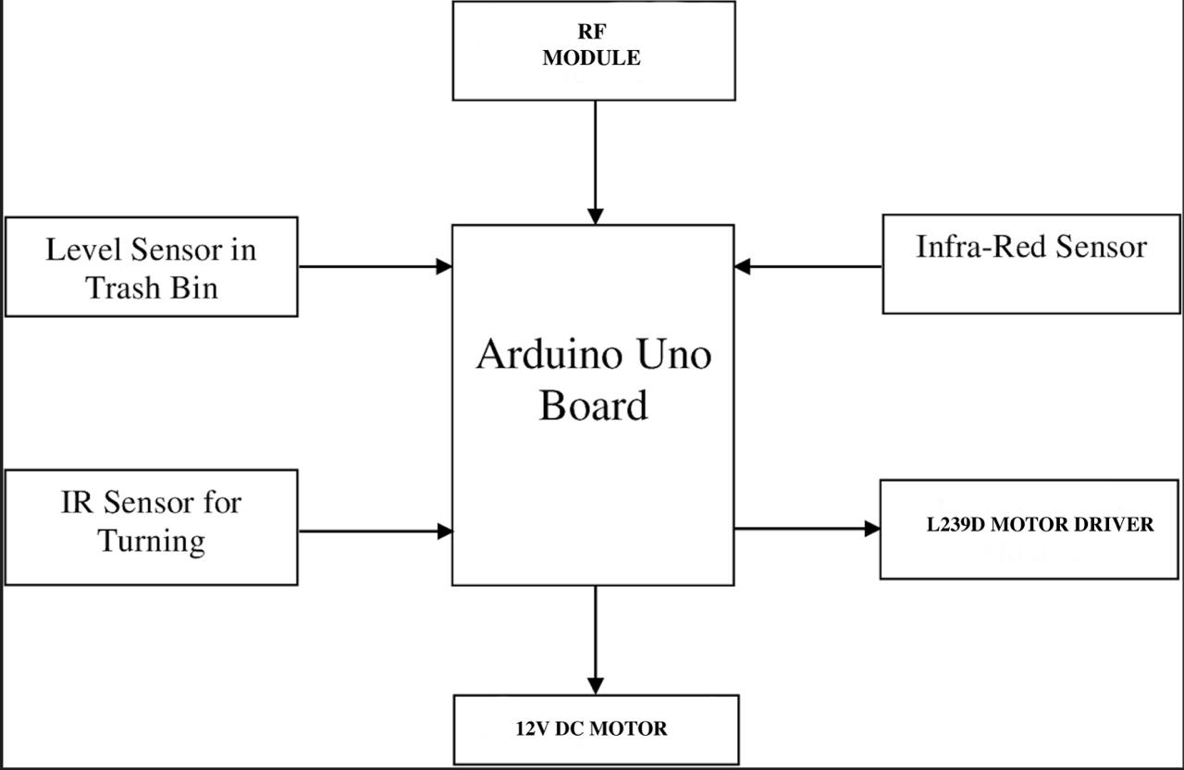
SYSTEM ARCHITECTURE
DEPARTMENT OF COMPUTER SCIENCE AND ENGINEERING

Slide 6
DEVELOPMENT ENVIRONMENT
HARDWARE REQUIREMENT
The hardware requirements may serve as the basis for a contract for the
specification of the entire system. It is generally used by software engineers
as the starting point for the system design.
ARDUINO UNO BOARD
12V DC MOTOR
IR SENSOR(3 Nos.)
ULTRASOUND SENSOR
SOFTWARE REQUREMENT
The software requirements for the autonomous garbage cart project primarily
include the Arduino Integrated Development Environment (IDE) for
programming the Arduino Uno Board. Additionally, libraries for sensor
integration and motor control will be essential for interfacing with the hardware
components effectively
DEPARTMENT OF COMPUTER SCIENCE AND ENGINEERING

Slide 7
COMPONENTS USED
1. Arduino Uno Board: This serves as the brain of the system, control and
executing the necessary algorithms for autonomous navigation and obstacle
avoidance.
2. Infra Red Obstacle Sensor: The IR obstacle sensor helps in detecting
nearby obstacles, allowing the garbage cart to navigate around them
effectively.
3. L293D Motor Driver: This motor driver enables the control of the 12V DC
motor, which provides propulsion to the garbage cart.
4. 12V DC Motor (30 RPM): The DC motor drives the movement of the
garbage cart, propelling it along its predefined routes.
5. NRF24L01 Module: This wireless communication module can be used for
remote monitoring and control of the garbage cart, allowing operators to
track its movements and receive status updates in real-time.
6. Ultrasonic Sensor: Similar to the IR sensor, the ultrasonic sensor aids in
obstacle detection and navigation, providing additional input for the garbage
cart to avoid collisions.
DEPARTMENT OF COMPUTER SCIENCE AND ENGINEERING

Slide 8
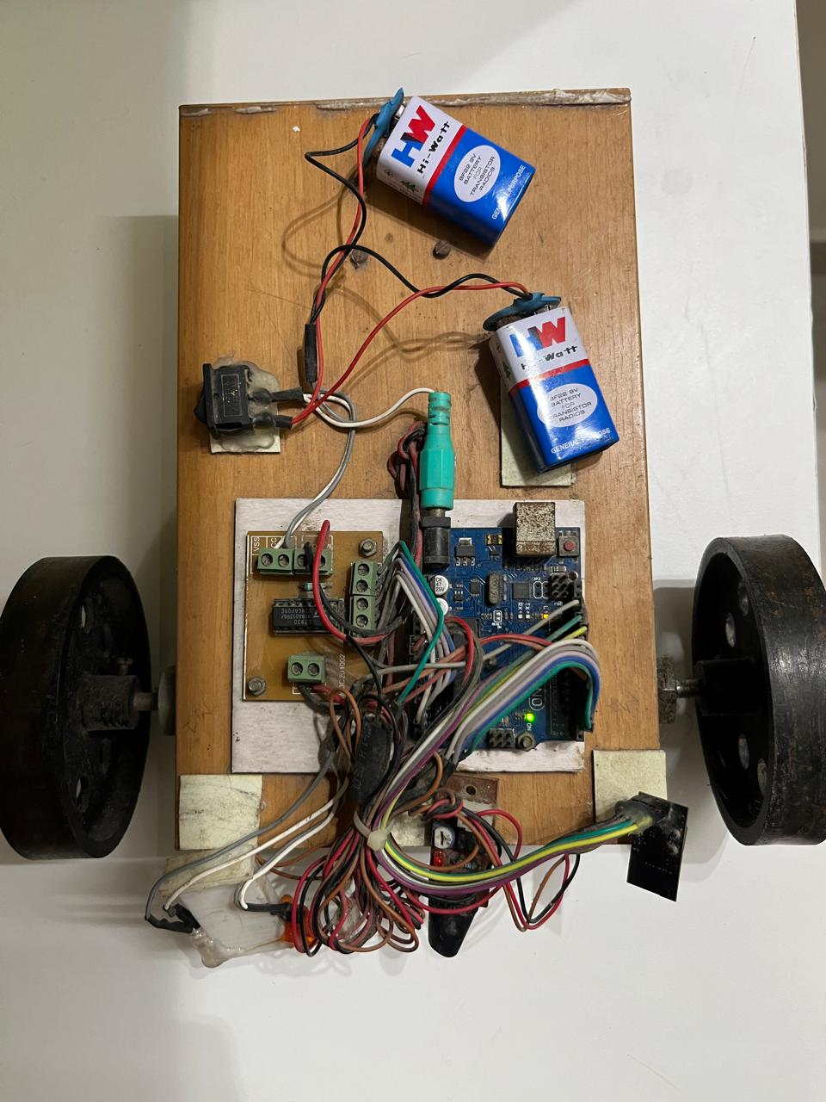
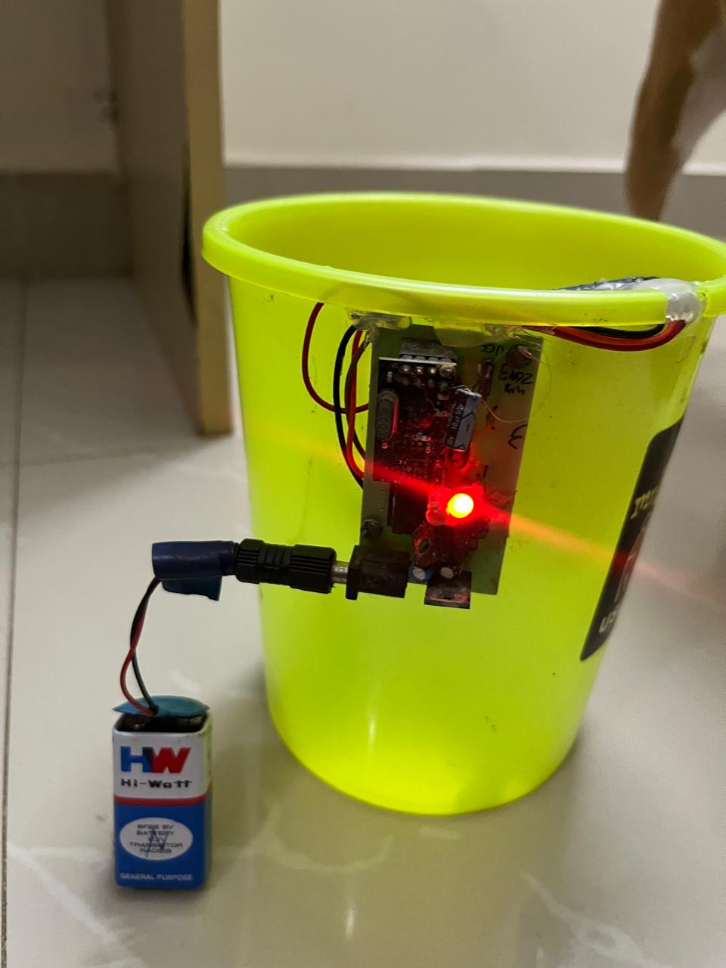
FINAL OUTPUT
DEPARTMENT OF COMPUTER SCIENCE AND ENGINEERING

Slide 9
CONCLUSION
In conclusion, the project "AUTONOMOUS GARBAGE CART" prototype
represent a significant milestone in the pursuit of innovative solutions for urban
waste management. Through the successful demonstration of basic
functionalities, including obstacle detection, navigation, and waste collection, the
prototype showcases the potential of autonomous technology to revolutionize
traditional waste collection processes. While the prototype's capabilities are
currently limited, its successful performance validates the feasibility of the
concept and highlights areas for further refinement and enhancement.
DEPARTMENT OF COMPUTER SCIENCE AND ENGINEERING

Slide 10
REFERENCES
1. "Building the Internet of Things: Implement New Business Models, Disrupt Competitors, Transform Your Industry" by Maciej Kranz Data Analytics Using Python (Book)
2. "Designing Connected Products: UX for the Consumer Internet of Things" by Claire Rowland, Elizabeth Goodman, Martin Charlier, and Ann Light https://www.ncbi.nlm.nih.gov/
3. "The Internet of Things (The MIT Press Essential Knowledge series)" by Samuel Greengard https://www.covetus.com/blog/
4. "Building Arduino Projects for the Internet of Things: Experiments with Real-World Applications" by Adeel Javed
5. "Internet of Things (A Hands-on-Approach)" by Arshdeep Bahga and Vijay Madisetti
DEPARTMENT OF COMPUTER SCIENCE AND ENGINEERING

Slide 11
THANK YOU
DEPARTMENT OF COMPUTER SCIENCE AND ENGINEERING

